Slide 1
Financial Sales Dashboard
Data Analyst Internship — Task 4 Created using Power BI

Slide 2
Objective
The objective of this project is to design an interactive dashboard for analyzing financial sales data and presenting useful business insights.
The dashboard focuses on sales, profit, sales price, trends over time, and segment-wise performance.

Slide 3
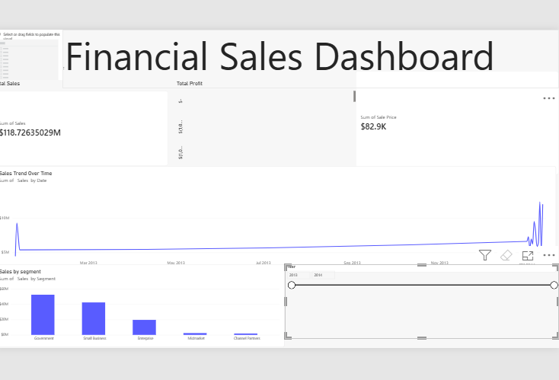
Power BI Dashboard

Slide 4
Key Insights
Total Sales provides an overview of overall sales performance. • Total Profit helps evaluate the profitability of the business. • Sales Trend Over Time shows how sales change over the selected period. • Sales by Segment helps compare performance across different customer segments. • Year and Segment slicers allow users to interactively filter the dashboard.

